Slide 1

Analyzing Global Access to Public Transport
Sankhya Sivakumar
October 31, 2023

Slide 2
Introduction
In today’s world, where cities are growing faster than ever, having good public transportation is key. It not only helps in making our cities more sustainable but also plays a vital role in reducing traffic and improving quality of life.
But how equal is access to public transport across different parts of the world? Do all urban areas, regardless of their country or region, enjoy the same level of accessibility?
With this analysis, we dive deep into these questions, aiming to shed light on the global patterns of urban access to public transport. We want to understand the variations, explore the extremes, and ultimately, paint a clear picture of where we stand today in terms of accessible urban mobility.

Slide 3

Understanding the data
Overview of the dataset
Key features
Title – ‘SDGI 11.2.1 Urban Access to Public Transport (2023 release)’
Description – This comprehensive dataset captures the accessibility of public transport across 182 countries, spanning over 13,135 urban centers globally. This dataset offers invaluable insights into urban development and mobility.
Source – NASA Socioeconomic Data and Applications Center (SEDAC) and Center for International Earth Science Information Network - CIESIN - Columbia University. 2023
Each urban center in the dataset is pinpointed with precise latitude and longitude coordinates, providing an accurate geospatial context for our analysis
The Accessible Population (Access_POP) metric quantifies the number of people within each urban center who have access to public transport. Convenient access to public transport is defined as being within a 0.5-kilometer walking distance of a low-capacity public transport point or within a 1-kilometer walking distance of a high-capacity public transport point.
Access Percentage (SDG1121pct) highlights the proportion of the total population that can conveniently access public transport, serving as a direct indicator of urban transport accessibility.
Few sample rows from the raw dataset:
Notes:
Column description:
CTR_MN_ISO: ISO unique three-letter country code
CTR_MN_NM: Country Name
UC_NM_MN: Urban Center Name
UC_NM_LST: List of Urban Centers in the Polygon (Shape/Geometry)
Total_POP: Total population of the Urban Center
Access_POP: Population who have access to public transport
SDG1121pct: percentage of population who have access to public transport
Shape_Leng: Length of the perimeter of the geometric shape
Shape_Area: Area of the geometric shape
Geometry: geometric data required for plotting
Low capacity transport point: bus stations in cities/highways, tram stops
High capacity: Ferry terminals, railway/subway stations

Slide 4
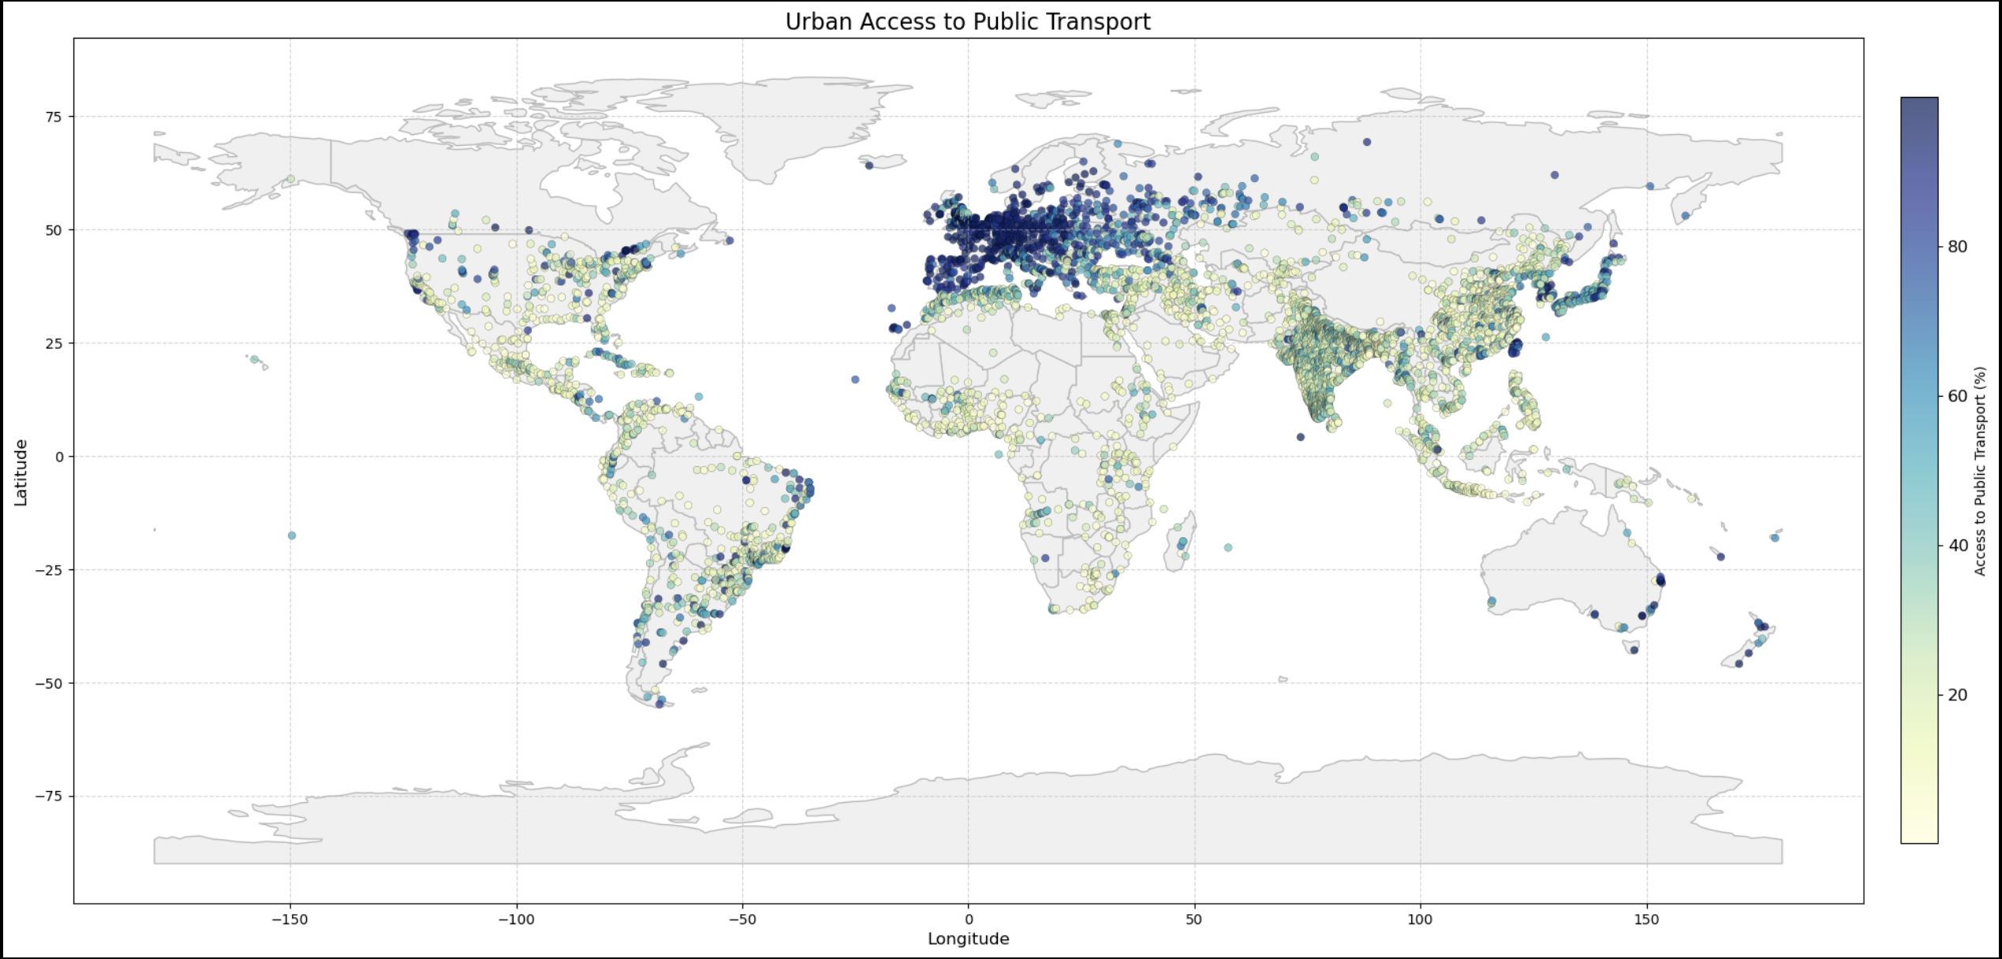
Urban public transport access is varied across nations
Europe showcases a robust public transport network across its urban centers
Regions in Africa exhibit significantly lower access to public transport

Slide 5
Access in the top 15 most populous countries
Key insights
Countries like China and India, despite their massive total populations, have a noticeable gap between total populations indicating areas of improvement in urban transport accessibility.
On the other hand, countries with smaller populations such as Japan, Russia, United Kingdom and South Korea showcase a higher access to public transport, reflecting their well-developed public transport networks.
Despite the United States economic prowess and advanced infrastructure, there's a noticeable disparity in public transport accessibility across its urban centers. This may be because of the country's vast geographical expanse and the predominant car culture, particularly in suburban and rural areas.
* The total population represents only the aggregated population of urban centers included in the dataset, and not the entire population of the country.

Slide 6
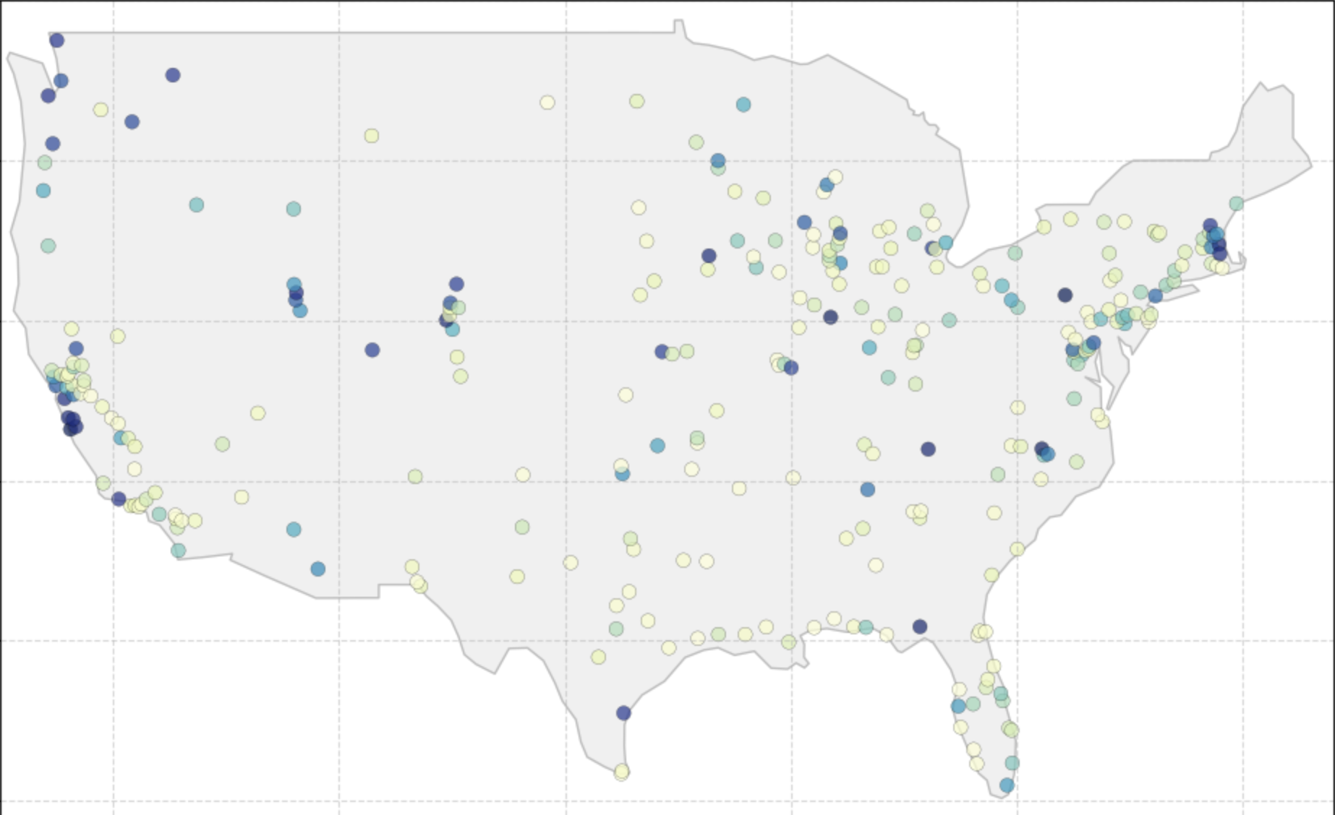
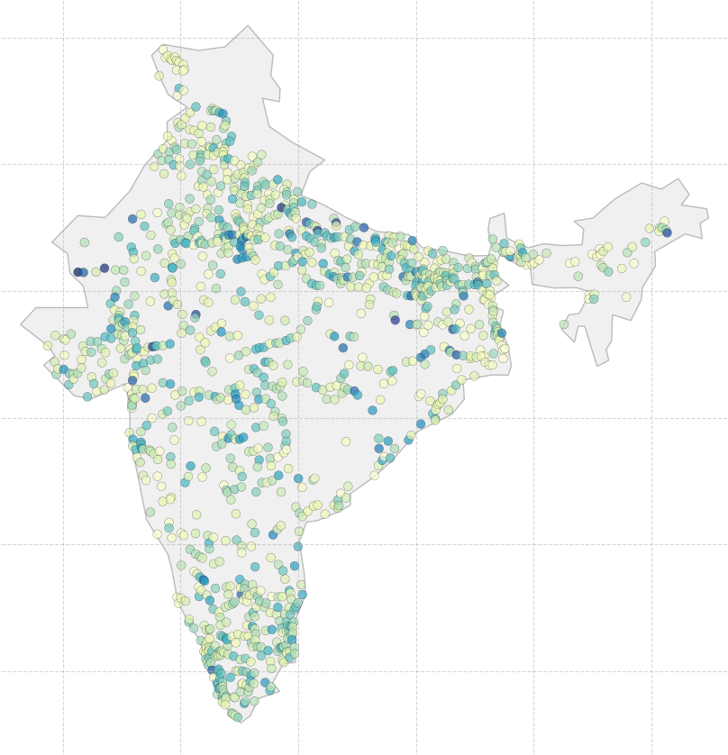
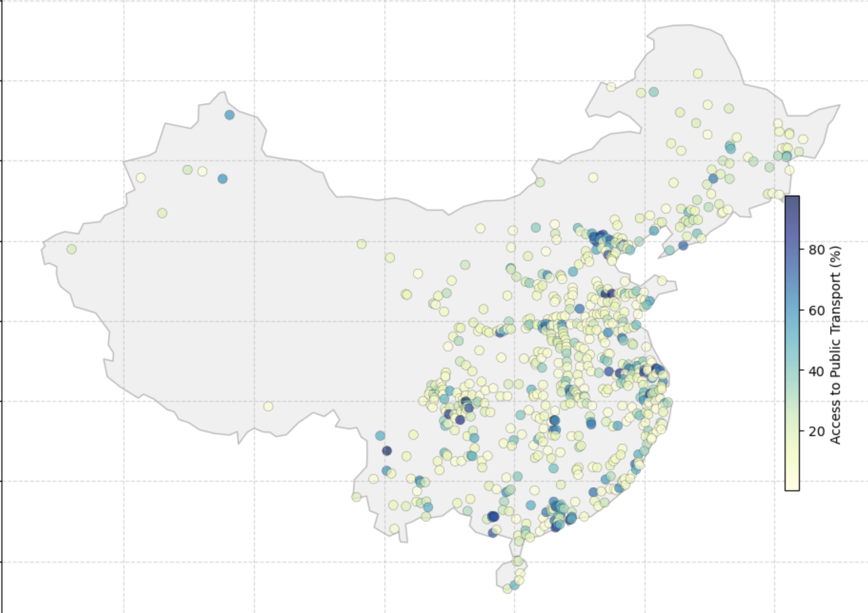
Urban Public Transport Access in the US, India, and China
United States
India
China
The map showcases a relatively high access to public transport across major urban areas on the East Coast and West Coast. However, there are regions in the Central parts of the country, that exhibit lower access.
Access to public transport is varied across the country, with higher access in some parts of North, West and South India. There are areas in the Central and Eastern regions with low access
Urban access to public transport is widespread, but it is noticeably higher in the eastern regions of the country compared to the western parts. This is reflective of China's economic landscape, where the eastern regions are more developed and urbanized.

Slide 7
Key Takeaways
Global disparity: This analysis has illuminated the stark disparities in urban public transport accessibility across different regions of the world.
The countries in Europe have extensive and efficient public transport networks with most of their population having access to it
Contrastingly, regions in Africa and parts of Asia exhibit significantly lower access, pinpointing areas where infrastructural development is required
Population vs Accessibility:
Countries like India, China and United States have an average access of 43%, 29% and 39% respectively, highlighting potential areas for enhancing public transport connectivity.
On the flip side, countries like United Kingdom, Russia and Japan have an average access of 88%, 77% and 76% respectively
This analysis highlights a clear global divide in urban public transport access, emphasizing the critical need for enhanced infrastructure in regions with low accessibility. Europe's public transport network sets a benchmark, showcasing the transformative impact of comprehensive planning and investment.

